Slide 1

Introduction to Prevention and Minimisation of Gambling Harm

Slide 2

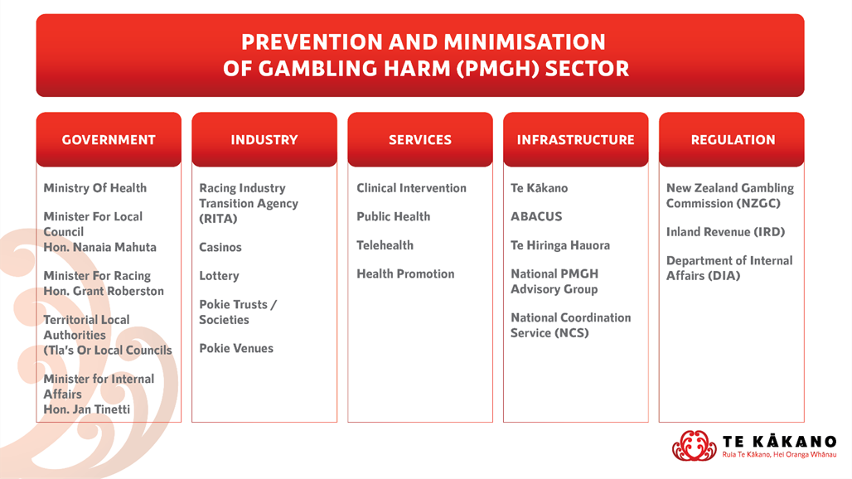
Gambling Sector Road Map
SLIDE 1

Slide 3
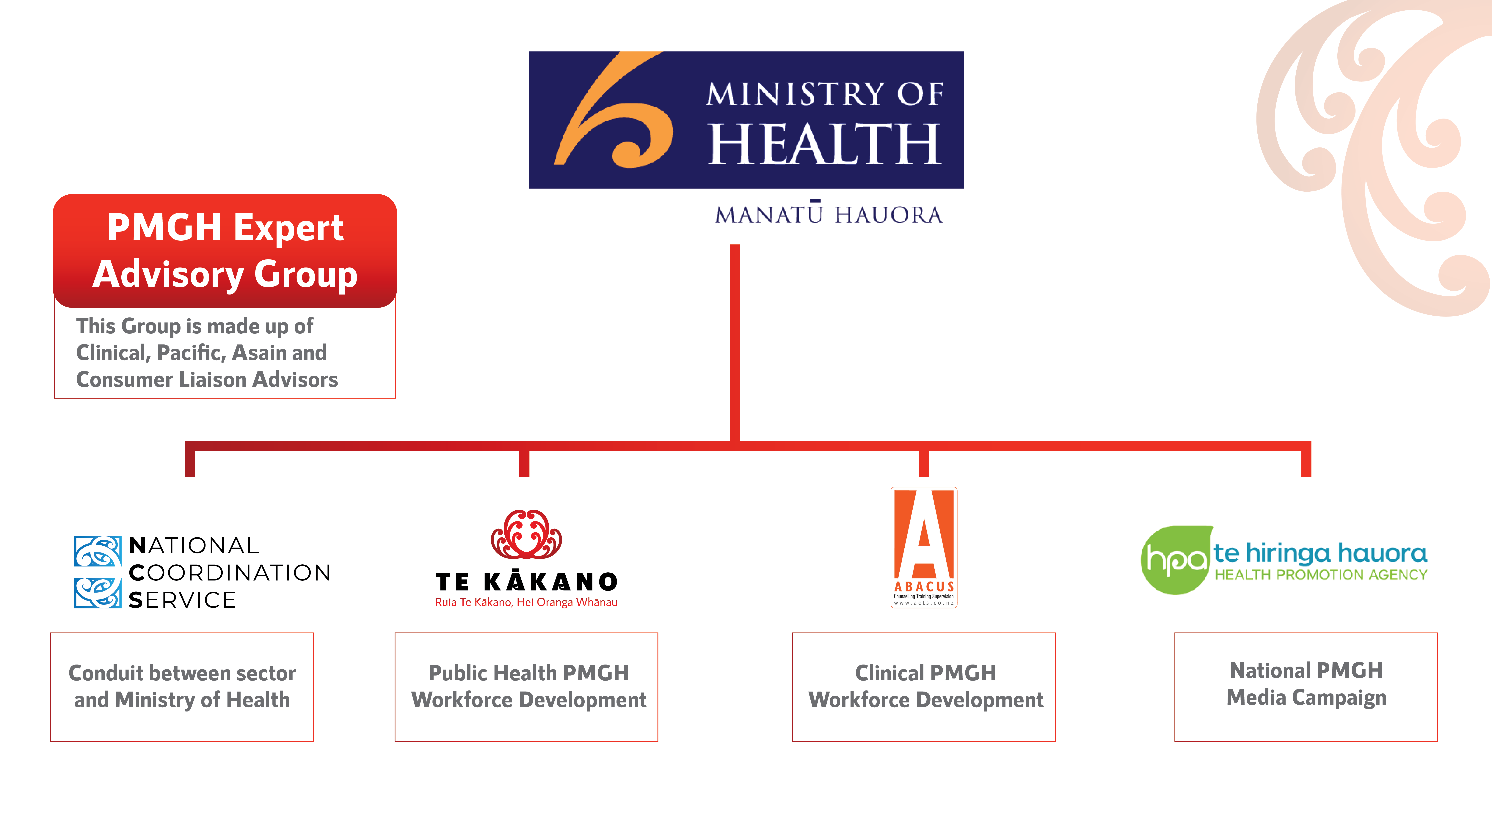
Infrastructure Services Overview
SLIDE 2

Slide 4
Gambling Act 2003
Gambling in New Zealand is legalised through the provision of the Gambling Act 2003
Purpose of this Act is to:
Control the growth of gambling
Prevent and minimise the harm caused by gambling, including problem gambling
Authorise some gambling and prohibit the rest
Facilitate responsible gambling
Ensure the integrity and fairness of games
Limit opportunities for crime or dishonesty associated with gambling and the conduct of gambling
Ensure that money from gambling benefits the community (g) ensure that money from gambling benefits the community
Facilitate community involvement in decisions about the provision of gambling.
http://www.legislation.govt.nz/act/public/2003/0051/113.0/DLM207497.html
SLIDE 3

Slide 5
Classes of Gambling
Class 1
Class 2
Class 3
Class 4
Office Sweepstakes, Raffles, etc. - $500 limit
Office Sweepstakes, Raffles, etc. - $5000 limit
Housie, TAB (Sports, Horses, Dogs)
Pubs, Clubs and Trusts Gaming Machines
Gambling that does not fall under a class of gambling
Casino
Lotteries
Private Gambling
Link to DIA: https://www.dia.govt.nz/diawebsite.nsf/wpg_URL/Services-Casino-and-Non-Casino-Gaming-Classes-of-Gambling
SLIDE 4

Slide 6
Strategy to Prevent and Minimise Gambling Harm
“The Gambling Act 2003 sets out requirements for an ‘integrated problem gambling strategy focused on public health’.
The Ministry of Health is responsible for developing and refreshing the strategy at three-yearly intervals, and for implementing it. The Crown recovers the cost of developing and implementing the strategy, by way of a ‘problem gambling levy’ set by regulation at a different rate for each of the main gambling sectors.”
Link to PMGH Strategy:
https://www.health.govt.nz/publication/strategy-prevent-and-minimise-gambling-harm-2019-20-2021-22
SLIDE 5

Slide 7
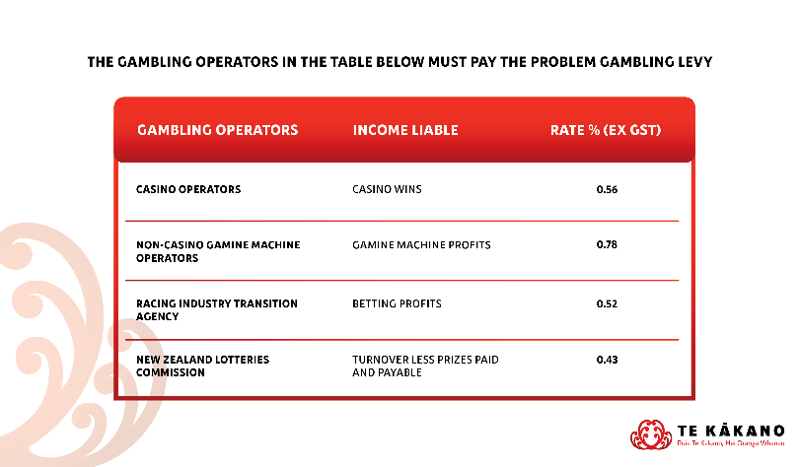
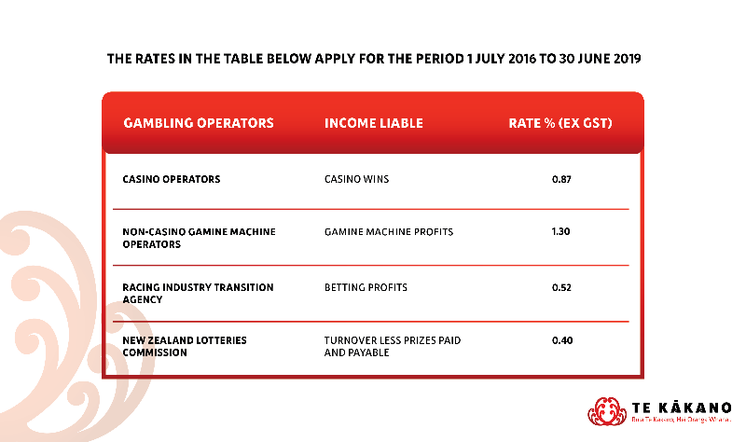
Gambling Levy
“Problem gambling services are funded through a levy on gambling operators. The levy is collected from the profits of New Zealand’s four main forms of gambling: gaming machines in pubs and clubs; casinos; the New Zealand Racing Board and the New Zealand Lotteries Commission.”
A problem gambling levy (PGL) must be paid on all gaming machine profits and casino wins.
The total payable on your profits will be worked out automatically when you file your: gaming machine duty return, or casino duty return.
https://www.ird.govt.nz/duties/problem-gambling-levy
SLIDE 6

Slide 8
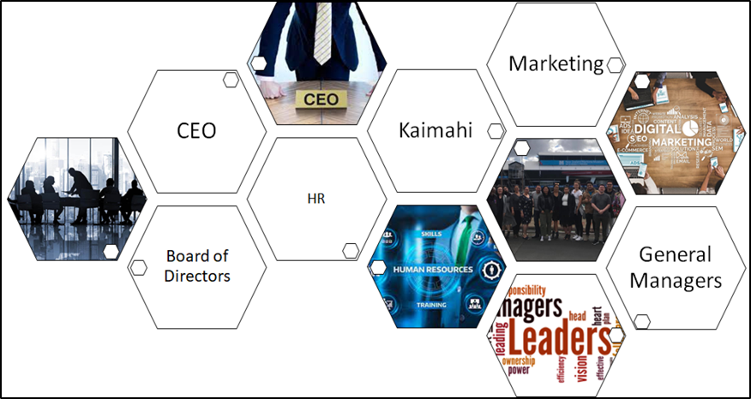
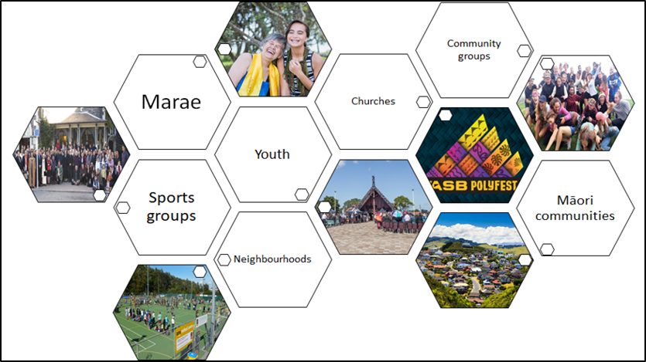
Potential Stakeholders
Key stakeholders reflect the project that you are delivering on, examples of stakeholders can be….
SLIDE 7

Slide 9
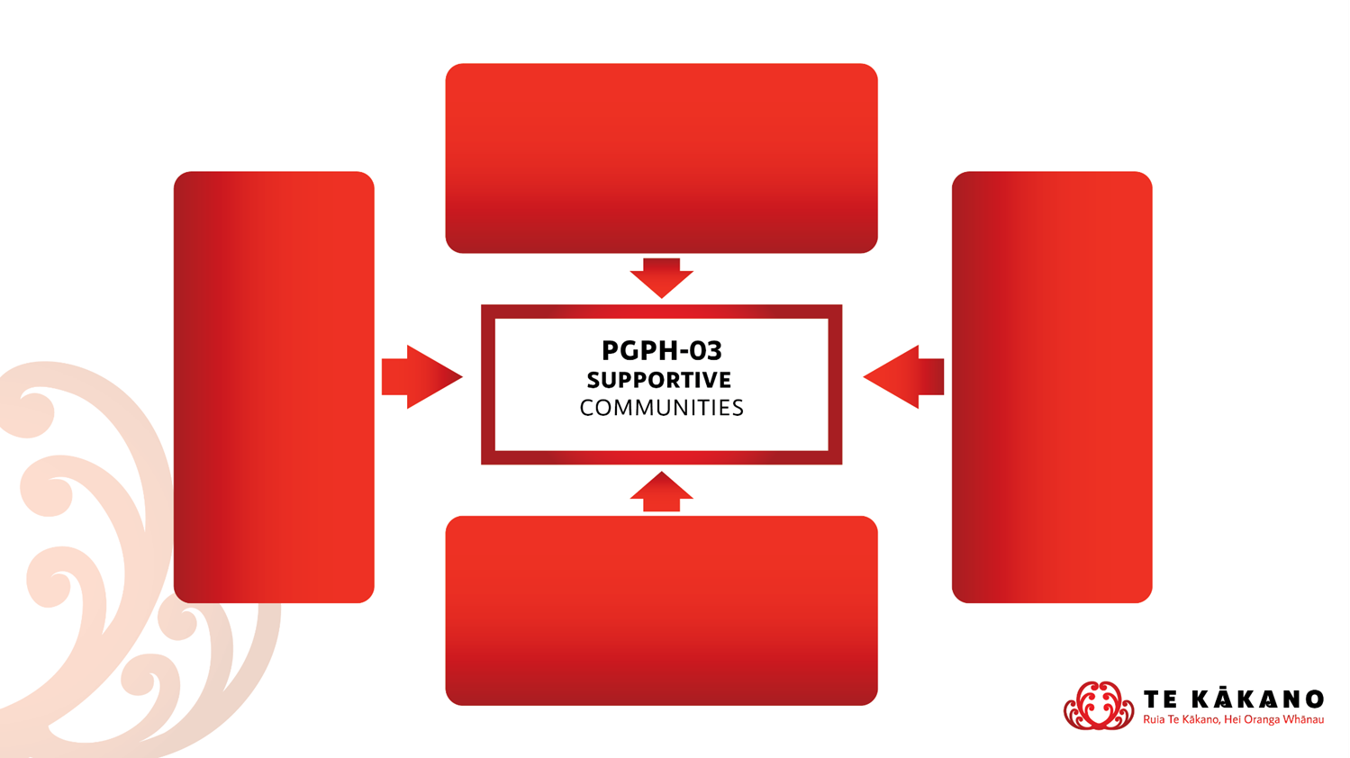
Specifications
PGPH-02 – Safe Gambling Environments
Organisations, groups and individuals are aware of the potential harms that can arise from gambling and actively work to ensure that environments that provide gambling opportunities actively minimise harm and support individuals to make healthy choices
PGPH-05
Effective Screening Environments
All people at risk of experiencing harm from gambling are identified as early as possible and are supported to access appropriate gambling harm interventions services
PGPH-03 Supportive Communities
People live in communities that provide strong protective factors and support individual and family resiliency
PGPH 01 – Policy Development and Implementation Government agencies, social organisations, private industry and businesses will actively work to reduce the harm occurring from gambling in their own places of business and re-orient their services to actively support reductions in gambling related harm where possible
PGPH-04 – Aware Communities
Agencies, communities, families and individuals are aware of the range of harms that can arise from gambling
SLIDE 8

