Slide 1

Policy Development and Implementation

Slide 2

Introduction to Policy Development and Implementation
“Government agencies, social organisations, private industry and businesses will actively work to reduce the harm occurring from gambling in their own places of business and re-orient their services to actively support reductions in gambling related harm where possible.”
https://www.health.govt.nz/system/files/documents/publications/hp7137-strategy-minimise-gambling-harm-jun19.pdf

Slide 3
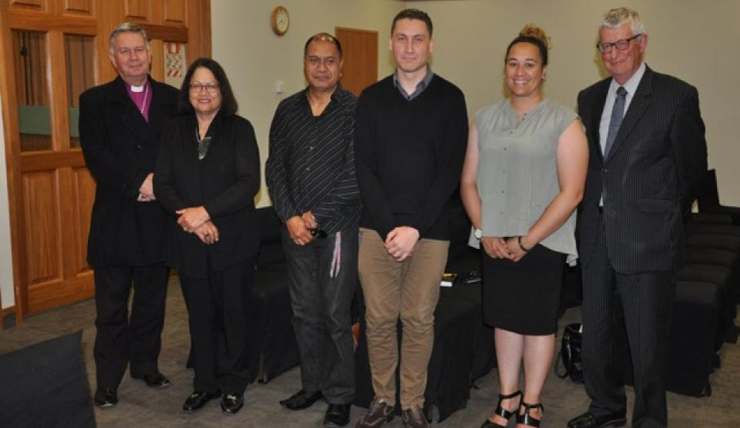
Kōrero Pono: Real Talk
SkyCity Hamilton Black Jack Tables to be replaced with 60 Pokie Machines
Lead Agency: Te Kohao Health
November 2019
He Taumata Blog Summary
https://hetaumata.co.nz/news/skycity-hamilton-submission-hearing
Te Ao Māori News Media Article
Māori man breaks his silence subjected to a 25 year gambling addiction. Now, he speaks out against Skycity Casino in Hamilton at the second hearing that sees the company push for more pokies machines.
Jason Rippey, 43, told Te Ao Māori News he has spent over $500,000 on gambling and has also spent ten years at the Hamilton based Skycity Casino.
https://www.teaomaori.news/skycity-gambling-hidden-agendas-claims-maori-health-provider

Slide 4

Kōrero Pono: Real Talk
SkyCity Hamilton Black Jack Tables to be replaced with 60 Pokie Machines
Lead Agency: Te Karere & Te Kohao Health
Date: 21 November, 2019
Sky City is looking to increase the number of its pokie machines at their Hamilton casino. But one reformed gambling addict says its not worth the harm and has taken his concerns to the Gambling Commission

Slide 5
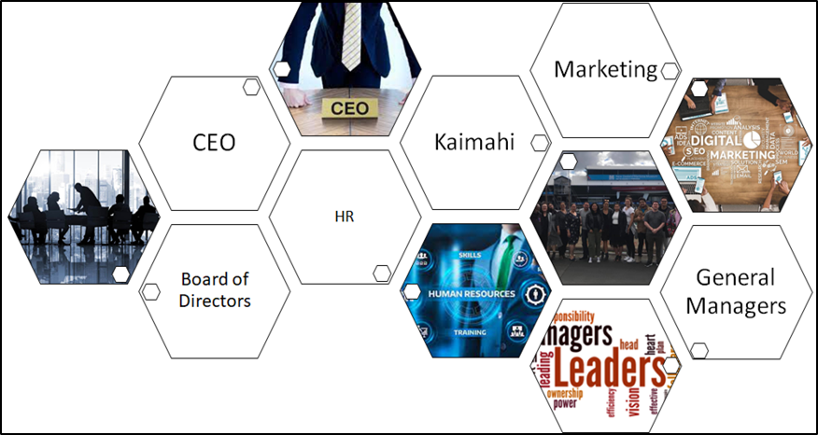
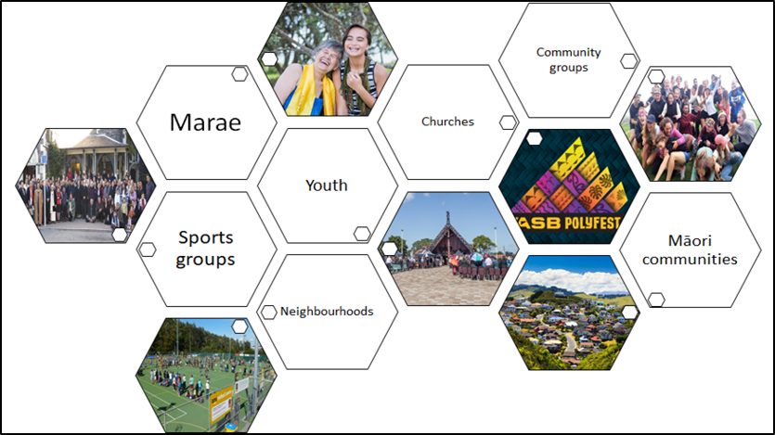
Potential Stakeholders
Key stakeholders reflect the project that you are delivering on, examples of stakeholders can be….

Slide 6
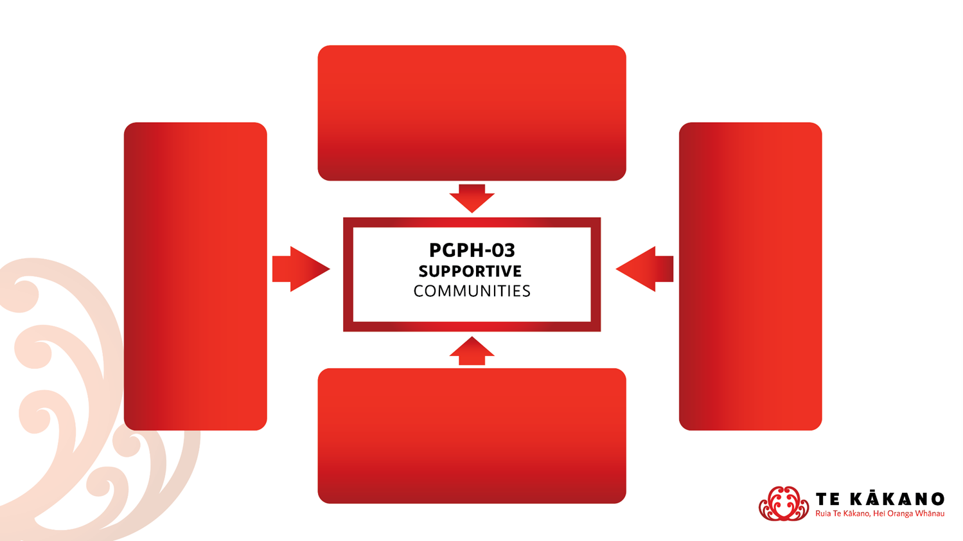
Potential Stakeholders
PG PH-02 – Safe Gambling Environments
Creating policy that reduces gambling harm to be implemented for environments
e.g. Sinking Lid Policy to reduce new pokies at venues
PGPH-05
Screening Environments
Working with other organisations to develop policy recommendations e.g. the Te Ngira Collective
PGPH-03 Supportive Communities
Working with communities to get their voice included in the development of policy e.g. community workshops that inform submissions
PGPH-01 Policy Development and Implementation
PGPH-04 – Aware Communities
Promoting the harms of gambling and creating awareness through developing programmes and resources e.g. Community submission templates

Slide 7
Alignment to Objectives
Examples of alignment to Strategic Prevention & Minimisation of Gambling Harm Objectives
Objective 4 – Healthy policy at the national, regional and local level
prevents and minimises gambling
Indicates that preventing and minimising gambling harm relies on a foundation of relevant and effective public policy at a national, regional and local level
Objective 6 – A skilled workforce is developed to deliver effective services
to prevent and minimise gambling
Establishing a Prevention and Minimisation Gambling Harm workforce that is diverse and has a robust health equity, cultural competency and health literacy focus.

