Slide 1

Supportive Communities

Slide 2

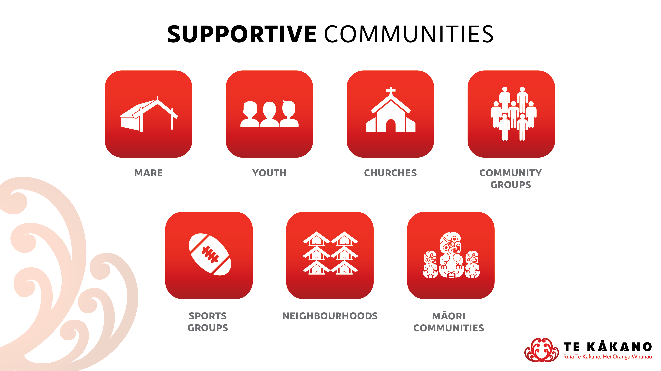

Slide 3
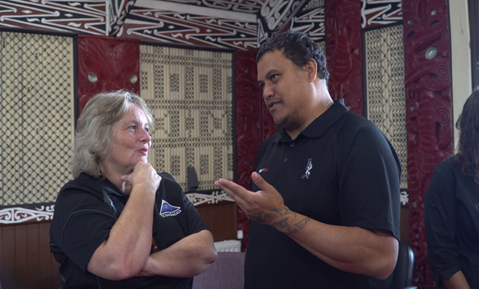
Introduction to Supportive Communities
“People live in communities that provide strong protective factors and support individual and family resiliency.”
https://nsfl.health.govt.nz/system/files/documents/specifications/problemgamblingserviceprogramme.doc

Slide 4

Korero Pono - Real Talk
Video Example of Community Engagement

Slide 5

Potential Stakeholders
Key Stakeholders reflect the project that you are delivering on
COMMUNITIES
https://hetaumata.co.nz/service-providers

Slide 6
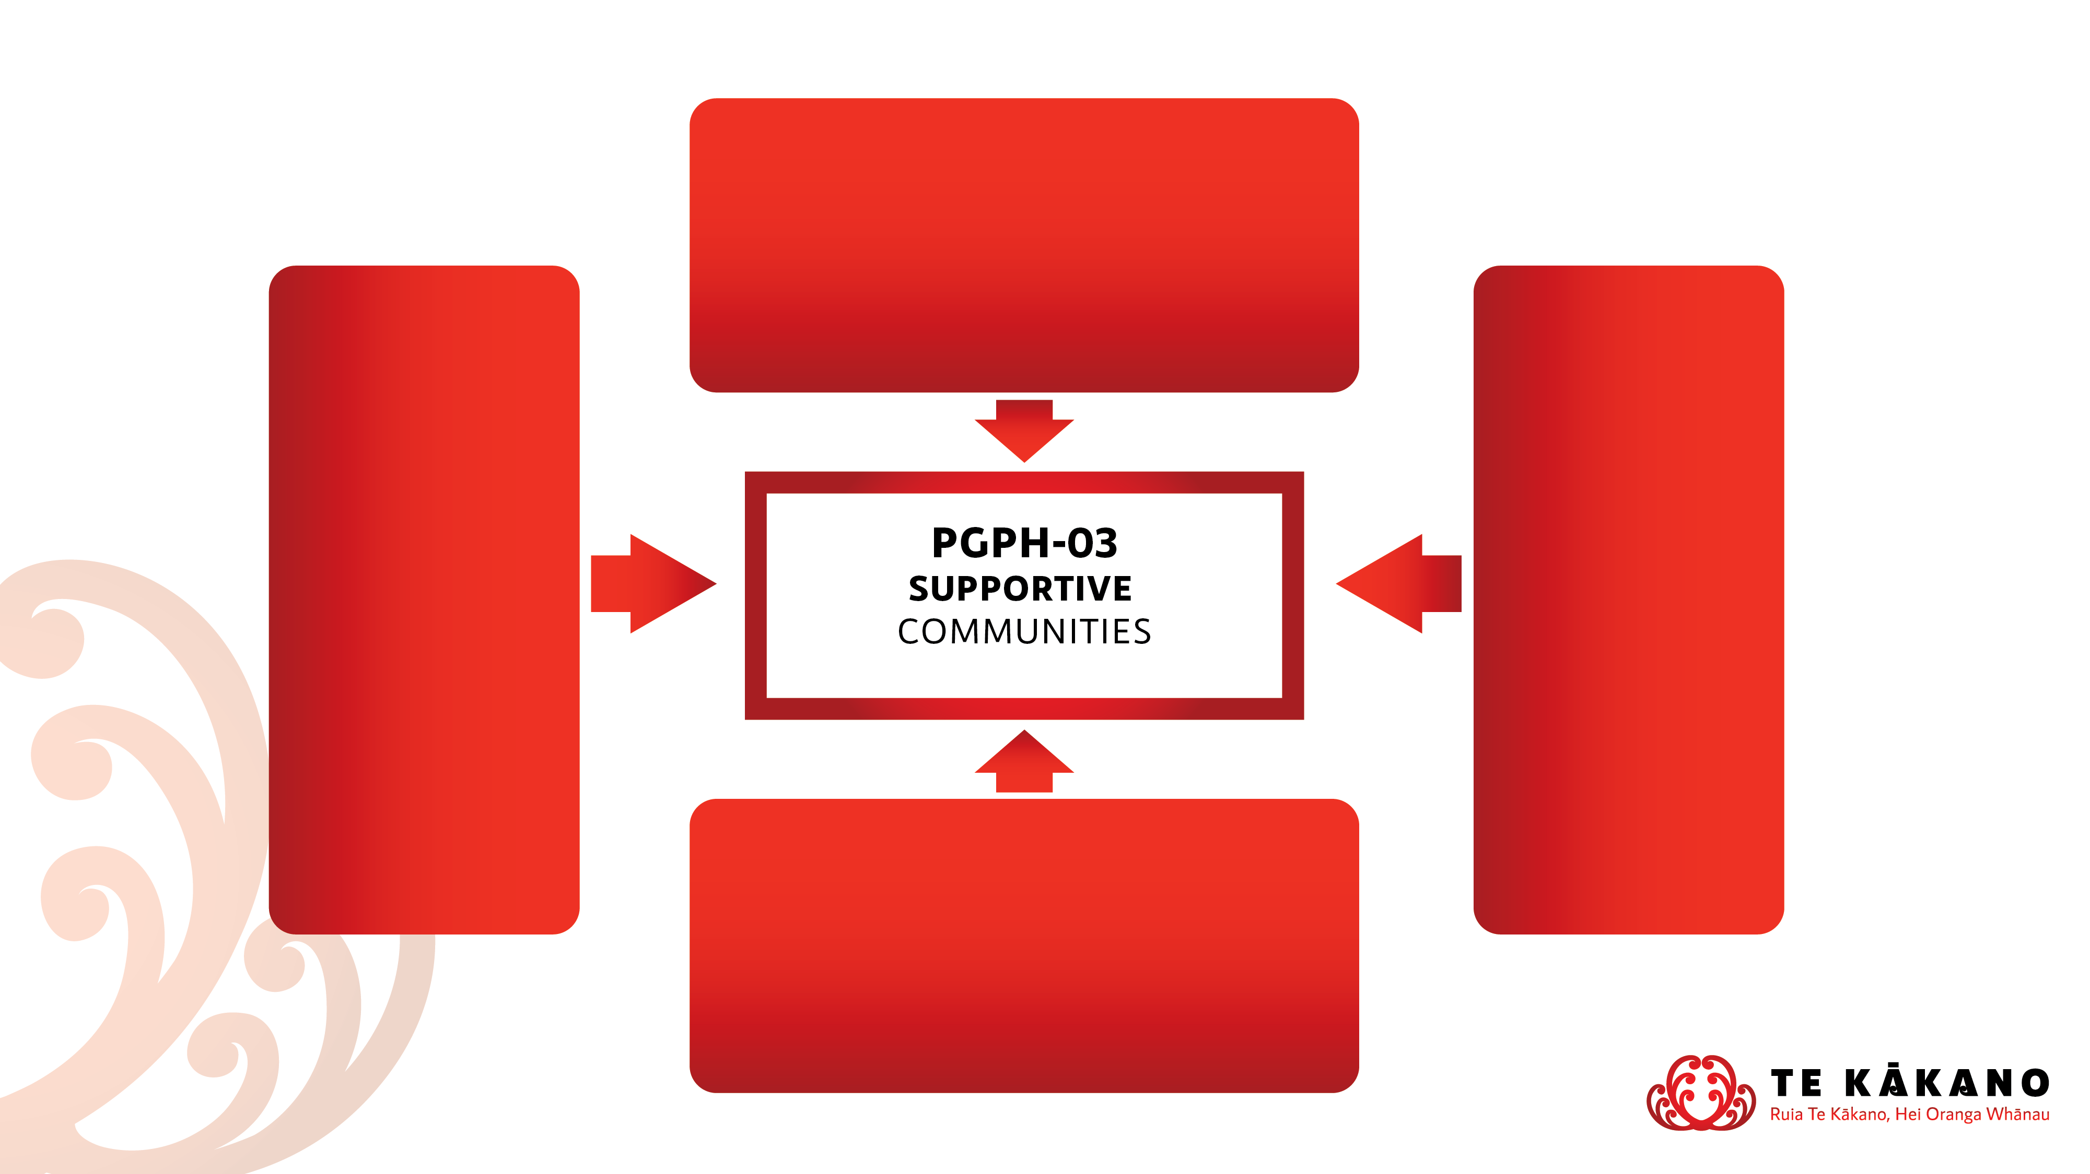
Relationship to Prevention Minimisation Gambling Harm Specifications
PGPH 01 – Policy Development & Implementation
Creating policy that is informed by the voice of the community
e.g. community submission templates and community workshops
PGPH 05 – Effective Screening Environments
Working with organisations to create safe brief screening environments that are community friendly
e.g. gambling harm promotion in community environments
PGPH 02 – Safe Gambling Environments
Ensuring gambling environments are providing gambling harm awareness to their patrons
e.g. visiting venues to ensure the host responsibility is understood and met
PGPH 04 – Aware Communities
Promoting the harms of gambling and creating awareness through developing programmes and resources
e.g. resources that are relevant to the community you’re engaging with

Slide 7
Alignment to Objectives
Examples of alignment to Strategic Prevention & Minimisation of Gambling Harm Objectives
Objective 3 – People participate in decision-making about activities in their communities that prevent and minimise gambling harm
Indicates the important role of people and communities participating in decision-making about local activities that prevent and minimise gambling harm
Objective 5 – People understand and acknowledge the range of gambling harms that affect individuals, families, whanau and communities
Indicates that Supportive Communities assist in educating people in life skills and resilience to make healthy choices that prevent and minimise gambling harm

