Slide 1

Aware Communities

Slide 2

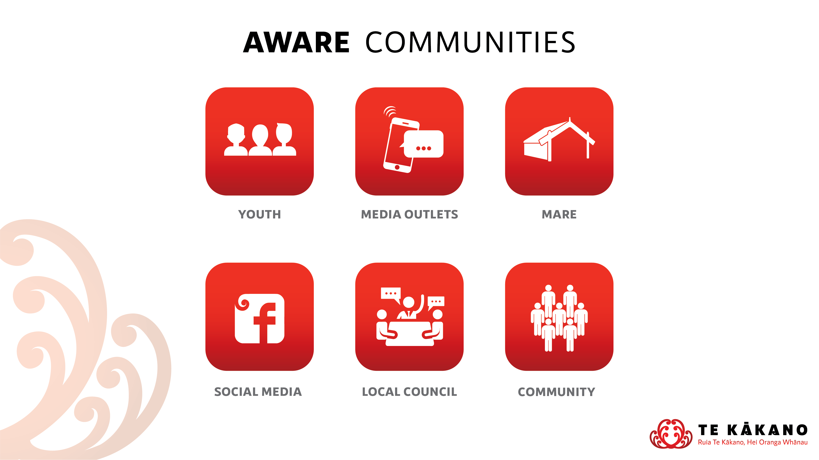

Slide 3
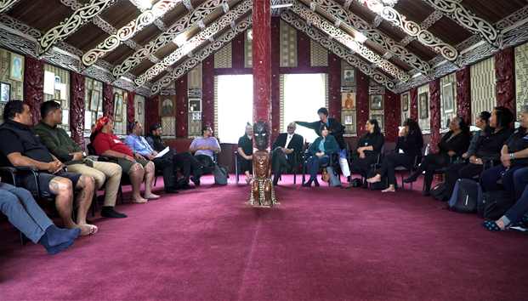
Introduction to Aware Communities
“Agencies, communities, families and individuals are aware of the range of harms that can arise from gambling.”
https://www.dia.govt.nz/Services-Casino-and-Non-Casino-Gaming-Problem-Gambling

Slide 4
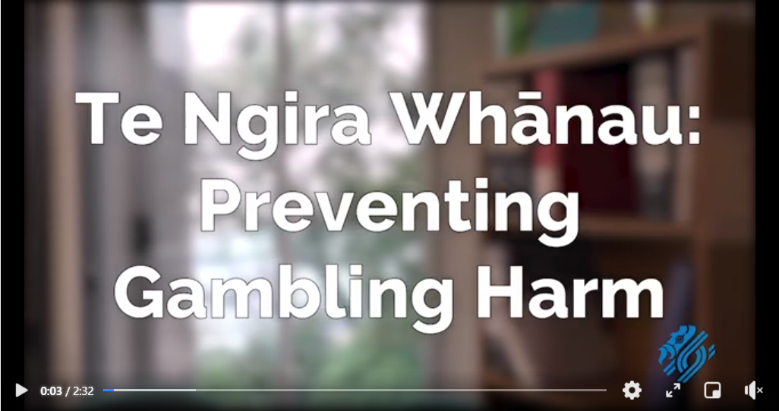
Korero Pono - Real Talk
Video Example of Increasing Awareness Communities of Problem Gambling within our communities

Slide 5
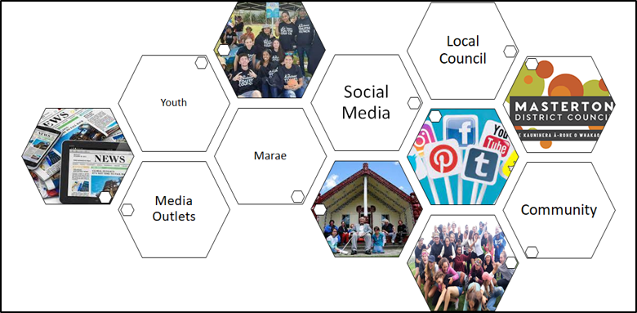
Potential Stakeholders
Key Stakeholders reflect the project that you are delivering on
ADVOCACY
https://hetaumata.co.nz/service-providers

Slide 6
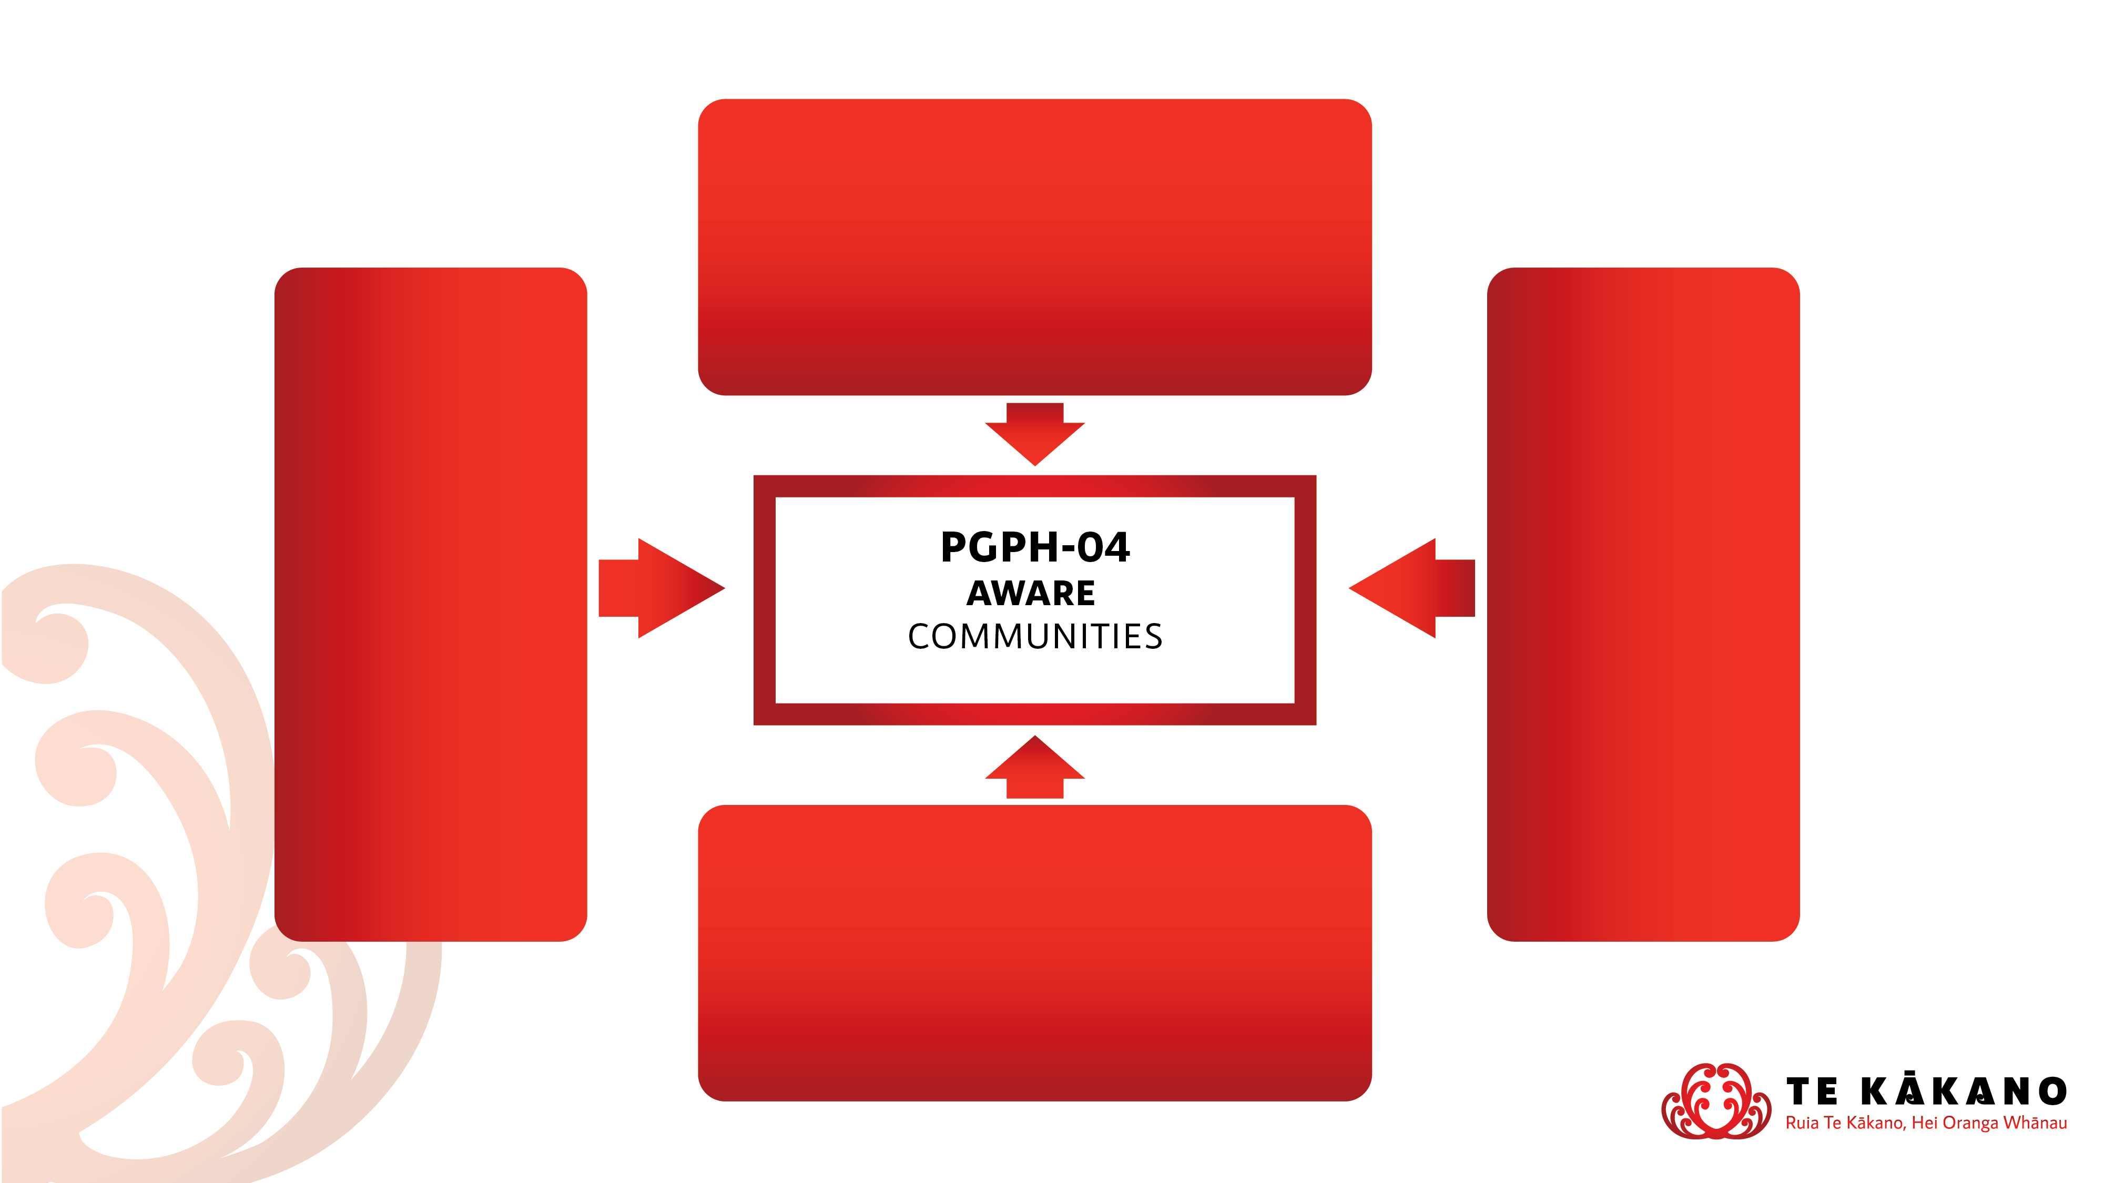
Relationship to Prevention Minimisation Gambling Harm Specifications
PGPH 01 – Policy Development and Implementation
Creating and advocating for policy that is informed by the voice of the community
e.g. promoting communities to have their say on policy changes
PGPH 05 – Effective Screening Environments
Working with organisations to create safe brief screening environments that are community friendly
e.g. gambling harm promotion in community environments
PGPH 02 – Safe Gambling Environments
Ensuring gambling environments are providing gambling harm awareness to their patrons.
e.g. visiting venues to ensure that host responsibility is understood and met
PGPH 03 – Supportive Communities
Working with communities effectively to promote and understand gambling harm
e.g. community workshops that educate about gambling harm

Slide 7
Alignment to Objectives
Examples of alignment to Strategic Prevention & Minimisation of Gambling Harm Objectives
Objective 2 - Māori have healthier futures
Indicates that projects are driven by kaupapa Māori
Objective 4 - Healthy policy at the national, regional and local level prevents and minimizes gambling harm
Indicates that services are able to engage with gambling policy at all levels and advocate for prevention and minimisation of gambling harm
Objective 11 - A programme of research and evaluation establishes an evidence base that underpins all activities
Indicates that services are aware of latest evidence, to distribute to communities to understand

