Slide 1

Effective Screening Environments

Slide 2

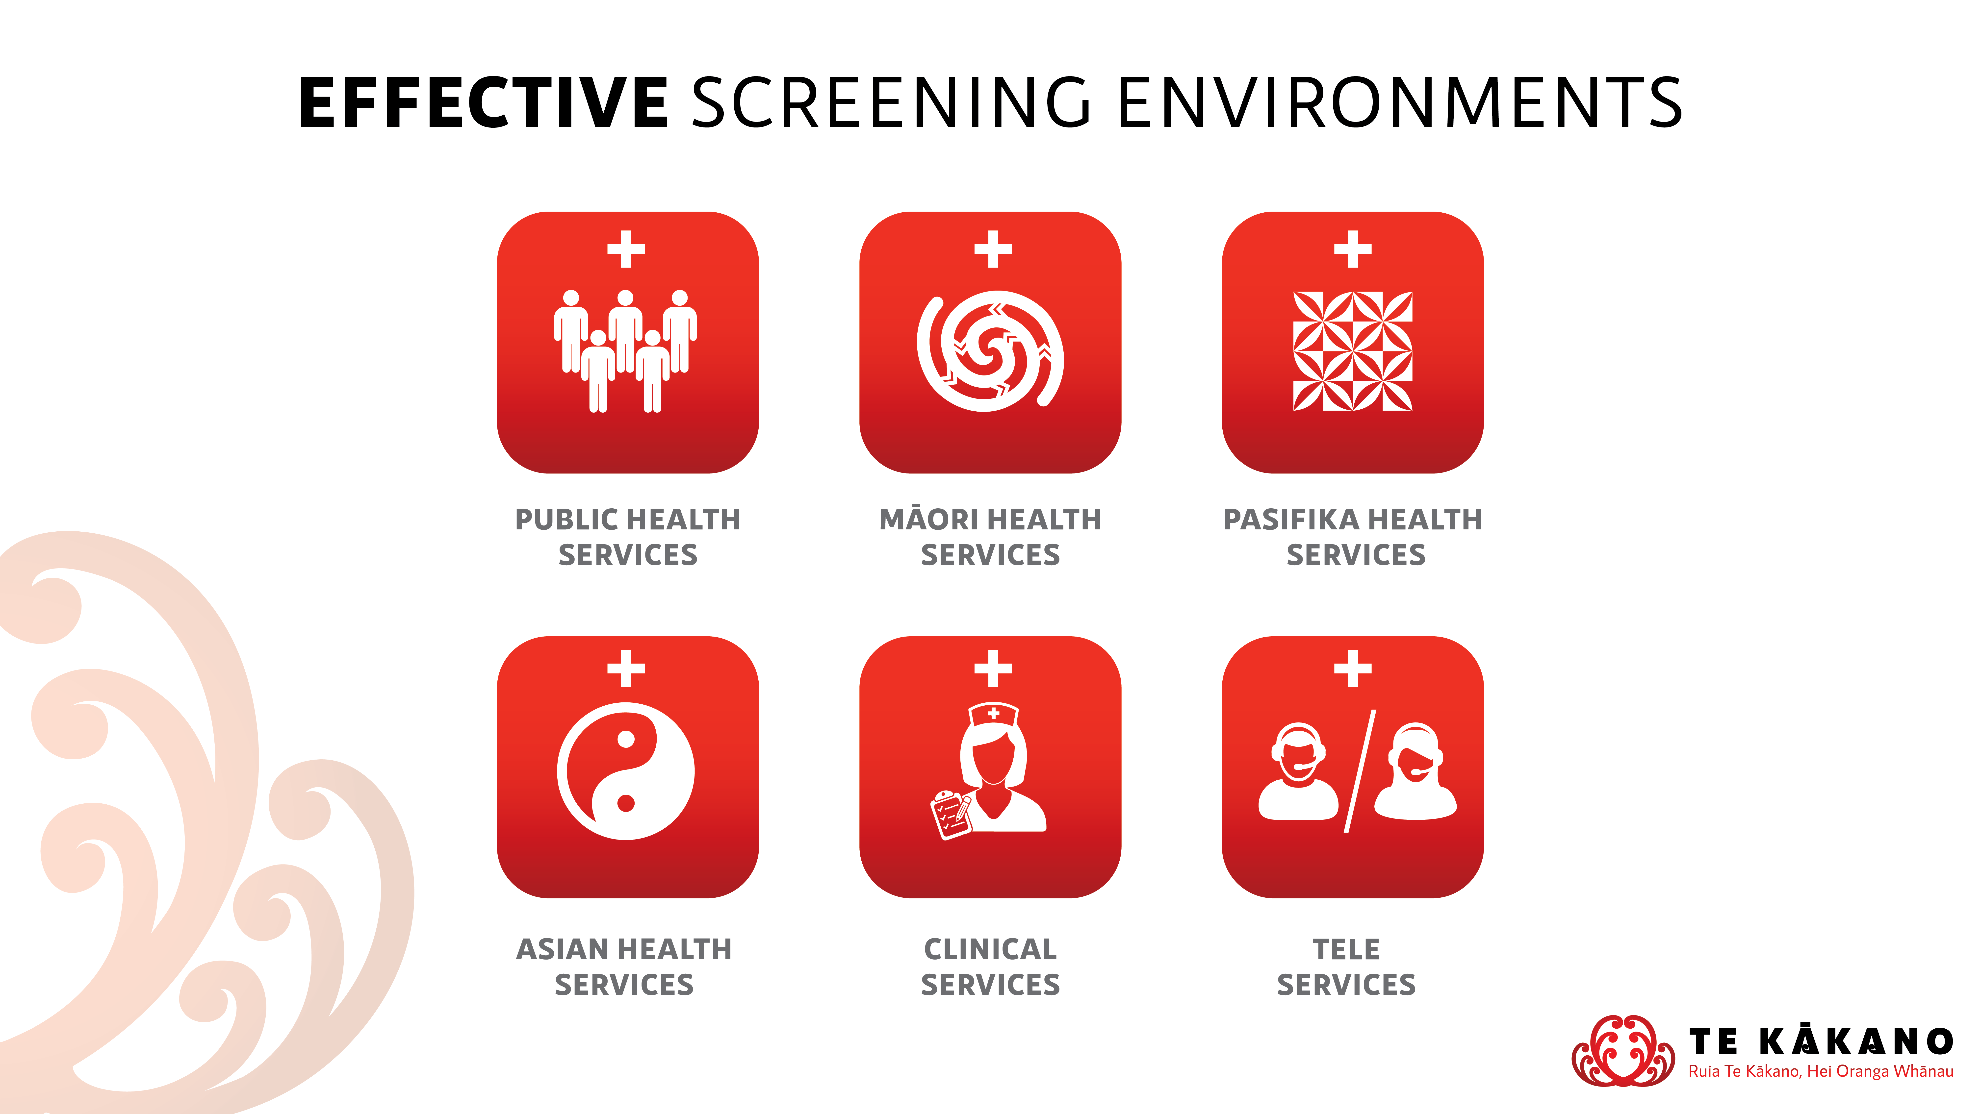

Slide 3
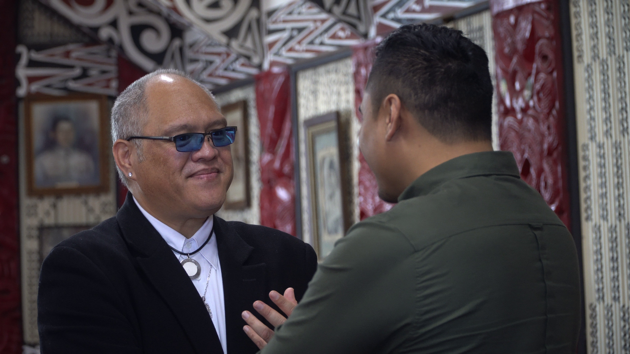
Introduction to Effective Screening Environments
“All people at risk of experiencing harm from gambling are identified as early as possible and are supported to access appropriate gambling harm intervention services.”
https://studylib.net/doc/9536263/evaluation-and-clinical-audit-of-problem

Slide 4

Korero Pono - Real Talk
Video Example of Effective Screening Environments process
https://garc.aut.ac.nz/our-research/nz-national-gambling-study

Slide 5
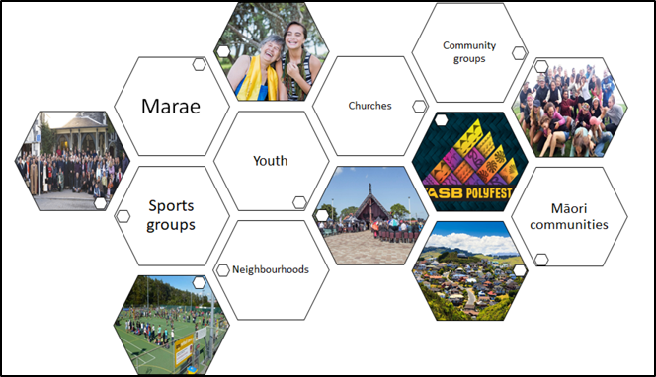

Potential Stakeholders
Key Stakeholders reflect the project that you are delivering on
COMMUNITY
SECTOR
https://hetaumata.co.nz/service-providers

Slide 6
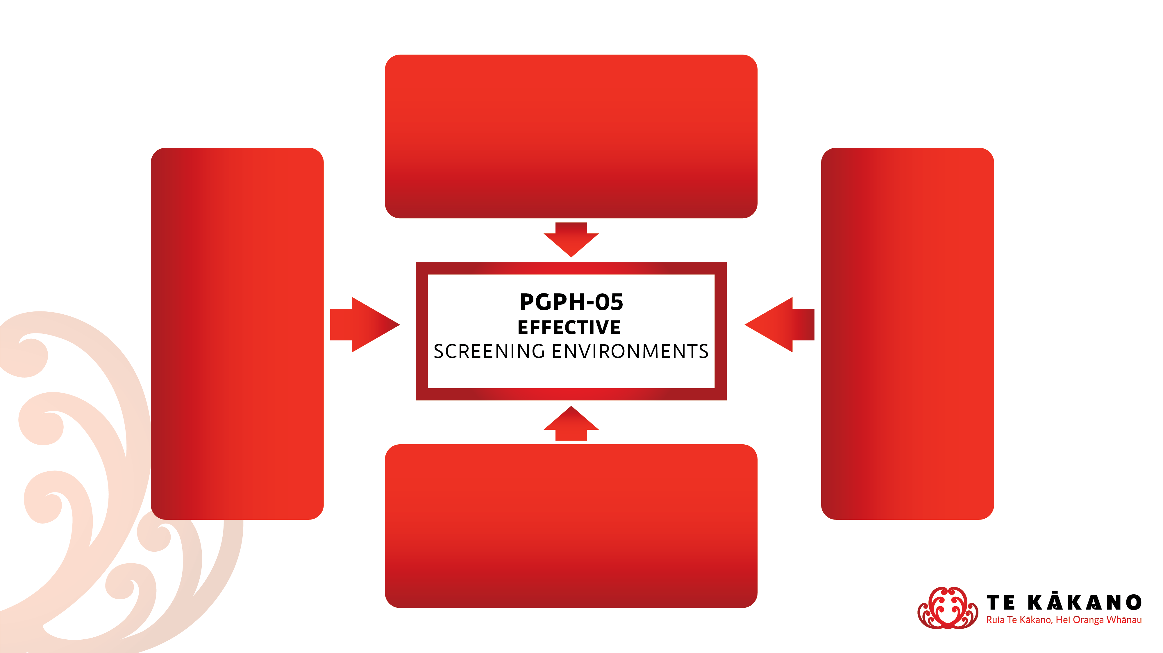
Relationship to Prevention Minimisation Gambling Harm Specifications
PGPH 01 – Policy Development and Implementation
Creating policy that reduces gambling harm to be implemented for environments
e.g. working collaboratively with organisations to affect policy change
PGPH 04 – Aware Communities
Promoting the harms of gambling and creating awareness through developing programmes and resources
e.g. resources that are relevant to the community you’re engaging with
PGPH 02 – Safe Gambling Environments
Ensuring gambling environments are providing gambling harm awareness to their patrons
e.g. visiting venues to ensure that they are aware of different services available
PGPH 03 – Supportive Communities
Working with communities effectively to promote and understand gambling harm
e.g. community workshops that educate about gambling harm

Slide 7
Alignment to Objectives
Examples of alignment to Strategic Prevention & Minimisation of Gambling Harm Objectives
Objective 8 - Gambling environments are designed to prevent and minimise gambling harm
  Indicates that environments are created to support community engagement
Objective 10 - People access effective treatment and support services at the right time and place
  Indicates that services are working together to deliver brief screening interventions

