Slide 1

Workforce Development Plans for Public Health Workers : Preventing & Minimising Gambling Harm

Slide 2
What Is Workforce Development?
Workforce development builds and supports the capacity of a workforce to deliver high-quality outcomes. Workforce development strategies influence areas such as:
Staff entering and exiting the sector
Staff movement between organisations and roles
Education, training and skill development
Values and attitudes
Workforce infrastructure such as education and labour markets
(Te Pou Te Whakaaro Nui)
Some useful definitions when discussing workforce development are:
Workforce development: building and supporting workforce capacity at individual, organisational and sector levels
Professional development: individually participating in formal and informal learning opportunities
Career development: a life-long process of planning and implementing career steps towards an evolving preferred future
A workforce development plan is a tool that can be used by kaimahi and managers to build knowledge and skills that progress professional, career and workforce development outcomes.

Slide 3
What Is A Workforce
Development Plan?
A workforce development plan is a form of goal setting - encompassing professional and career ambitions. It is a way to identify areas of your mahi that you would like to increase your capacity in or gain new knowledge in, explore and constructively utilize the resources available to you, and track your activities towards achieving these goals.
Workforce development plans focus on the big picture. Goals are long-term and take into account your interests and future aspirations. By continuously developing your levels of knowledge and understanding in a diverse range of areas, you are improving your current practice and future-proofing your career.
☑ Gain new knowledge
☑ Constructively utilize resources
☑ Achieve long-term goals
☑ Improve current practice
☑ Work towards future aspirations
☑ Future-proof career

Slide 4
Why Do We Need WFD Plans?
In the same way that we develop project plans to envision how we can achieve our public health outcomes, a workforce development plan maps the steps towards achieving your work-related goals. These plans are personal and grow with you, so you can reach and move the goal-posts at your own pace.
The aim is to progress professional development of practice and interests from linear movement to stair-cased growth. From an organisational perspective, supporting kaimahi to move through their individual WFD plans can improve outputs, increase employment retention and advance the development of the entire workforce.

Slide 5
Who Is Involved In WFD Plans?
Workforce development plans are kaimahi-led, where the kaimahi controls the direction and pace of their goals and the types of activities to be taken on.
The manager is responsible for helping develop the plan, supporting and reviewing the progress, approving funding to attend appropriate activities/trainings/events, and monitoring reasonable use of allocated funds. This can include time to attend planned activities, course and event costs, or even paper fees to subsidise tertiary education.
Te Kakano: tools, resources & individual support
Manager: plan development, review & attendance support
Kaimahi: direction, goals & actions
Te Kākano are responsible for developing and ensuring access to tools and resources, and conducting annual public health workforce development trainings. Te Kākano also offer individual support to public health workers in the gambling harm minimisation sector, including helping with the development and progress of WFD plans, support in finding appropriate WFD activities and education pathways, and managing need-based organisational trainings.

Slide 6
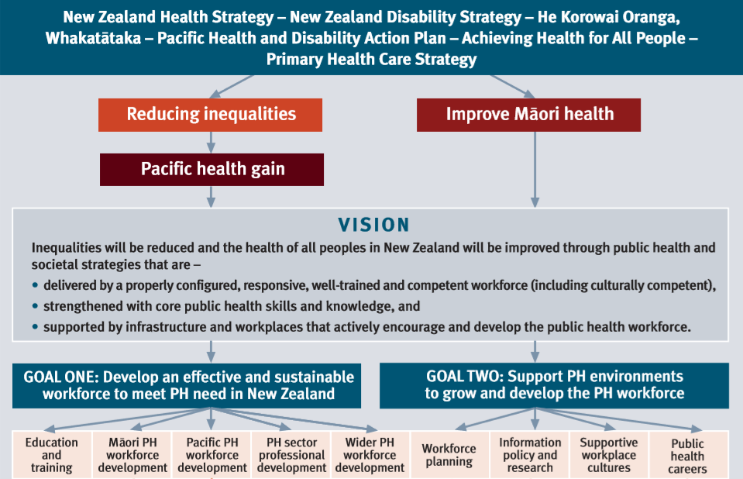
The National Public Health
WFD Plan
Te Uru Kahikatea is the national Public Health Workforce Development Plan 2007-2016 developed by the Ministry of Health.
This plan is designed to achieve two overarching goals:
Individual WFD plans support actions in most areas of the national plan
More information about Te Uru Kahikatea Public Health Workforce Development plan
☞ Other WFD plans & strategies, including specific plans for Māori and Pasifika

Slide 7
How Do I Get a WFD Plan?
Te Kākano are hosting an individual workforce development plan for each public health kaimahi in the gambling harm minimisation sector, via the personal login feature of the minimising gambling harm workforce hub: He Taumata. Online profiles are securely accessed via a personal login and can be updated by the kaimahi only.
To develop a WFD plan, start thinking about the areas of your mahi that you would like to develop, related areas of interest that you would like more knowledge in, and where you would like your career to be in five years. Discuss these points with your manager who can support you to develop some long-term goals, explore the resources available to you and identify some steps or activities to progress towards achieving your goals.
We are encouraging stair-cased development to help you aim high!. Your manager should be able to give you an indication of areas where your organisation can support you, and any activities that you may need to take the lead on.
Te Kākano have a range of WFD tools and resources on the website (via individual login). Te Kākano can be contacted for further support around goal setting, exploring education pathways, stair-casing your development and any other planning help.

Slide 8
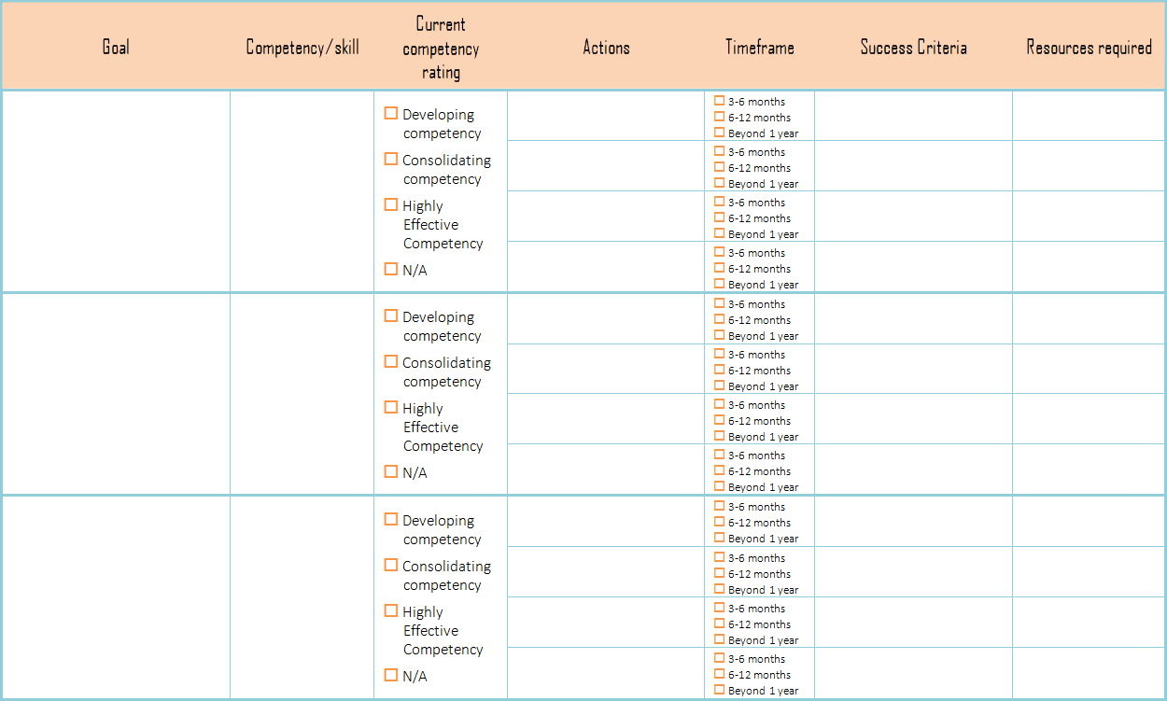
WFD Plan Template
A WFD plan template can be accessed through He Taumata via your personal login.
This template can be completed by kaimahi with the guidance of their managers to help identify where the organisation can offer resources to support goal achievement.

Slide 9
WFD Plan Timeline
It is important to set realistic timeframes when developing plans. Determining how to fit learning opportunities into your usual work and home life might not always be easy.
it is preferred to plan activities at your own pace - where long-term goals are broken down into smaller steps and set to a timeframe that fits your schedule. This basic timeline can be used as a guide for planning steps and actions towards achieving WFD goals.
3-6 months
Short steps towards goals
6-12 months
What would you like to be doing differently in one year?
Beyond 12 months
Goals with many steps
More ambitious goals
Tangible actions
Making headway on your plan
Quick wins?
Attend trainings/courses/ learning opportunities
Share new ideas with your team
Promotion? More responsibility? Your own team? Succession plan?

Slide 10
WFD Plan Example
As outlined in the WFD plan template, development of a workforce development plan follows this process:
Self-assess against the gambling public health competencies to help identify current strengths, and any areas that you identify to require more development.
Define the goals that you would like your organisation to help you achieve - taking into account your interests, current role, potential gaps in knowledge and future ambitions
Align your goals to the competency areas (if applicable) or define the skill you would like to develop in relation to each goal
Using the timeline as a guide, map out the steps or actions to help you achieve your WFD goals
Develop the success criteria for each action - what difference will this action make?
Identify the resources needed for each action and discuss with your manager which resources the organisation will contribute to and any that you may need to be responsible for

Slide 11
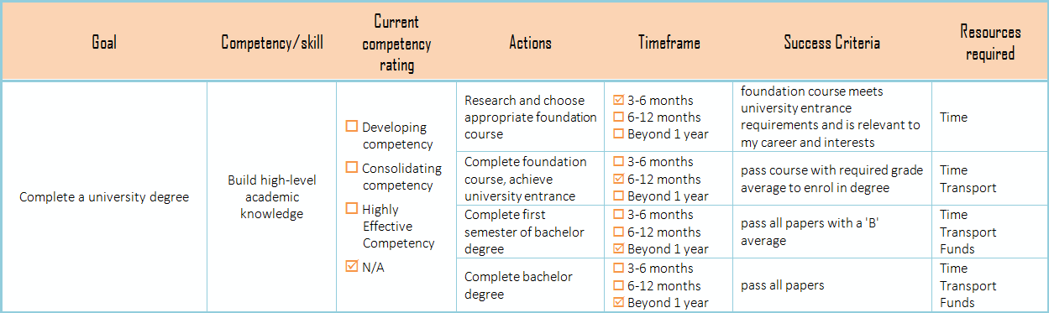
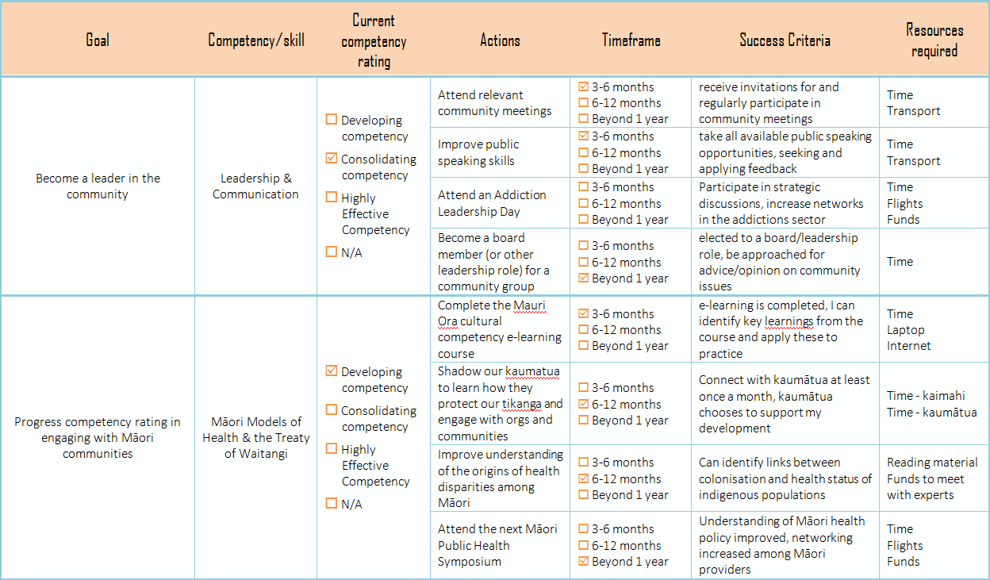
WFD Plan Example
Here is an example of three goals from a completed WFD plan:
A full WFD plan example can be accessed through He Taumata via your personal login.

Slide 12
Keeping Track of Your Plan
Te Kākano have made it easy to keep track of your workforce development plan online.
Through your personal login, you can review your plan, keep track of your achievements, add new goals and record key learnings.
You could also keep a hard copy of the original plan you developed with your manager, along with any resourcing decision records made while developing the plan.
It is best to review and revise your WFD plan at least once a year with your manager. Report-writing time is a good point to do this, as you can also extract outcomes for your WFD specification at the same time.

Slide 13
THANK YOU
Thank you for taking the first step towards advancing your professional development. Through growing the careers of our kaimahi we are increasing remuneration for whānau, enhancing gambling harm minimisation services for communities, and developing a more inter-connected public health workforce.
For further information please email Stephanie on:
stephanie.Erick@hapai.co.nz

